Slide 1


Slide 2

Farooq Ahmed Dar
Bilal Zahid
Muhammad Junaid Zafar
Irfan Sheikh
Rehan Ali

Slide 3

Mission Statement
“To provide more economical and reliable energy replacement”
Vision Statement
“Provide and implement sustainability plans that meet our clients focus on energy usage and protecting our environment”

Slide 4

The “Dominators Energy Solutions” is a Pakistan based company that falls under the category of “Small and Medium Industries/enterprise, engaged in the trading and servicing business.
The company is selling the solar energy equipment and related services. The services offered by the Company include the basic mechanism about how to handle and use the solar products. The company has its only outlet and showroom in the limits of Lahore.

Slide 5

Qualification & Designation
NAME | QUALIFICATION | DESIGNATIONS
Farooq Ahmad Dar | M.Sc Electrical Engineering | General Manager
Bilal Zahid | M.B.A (Finance) | Finance and Operations Manager
Irfan Sheikh | M.B.A | Inventory Manager
Junaid Zafar | M.B.A (HR) | HR Manager
Rehan Ali | M.B.A (Marketing) | Marketing and Sales Manager

Slide 6

Management Team
Our management team comprises of five managers of six different departments which will report to the G.M directly.
The five partners who pooled their capital and expertise will share the management tasks.
The strong determination of all the partners is to establish a strong foundation of the company and to capture the market as the name suggests “Dominator’s Energy Solutions”.

Slide 7

Capital Structure
Farooq Ahmed Dar | Rs. 5,000,000
Bilal Zahid | Rs. 5,000,000
M.Junaid Zafar | Rs. 5,000,000
M.Irfan Sheikh | Rs. 5,000,000
Rehan Ali | Rs. 5,000,000
Total | Rs. 25,000,000

Slide 8

Operations:
“Dominators Energy Solutions” is performing its operations in an office cum showroom located in the cavalry ground in Lahore Cantonment. Main office is accommodating G.M, operations, HR department and finance department above the main showroom and the showroom will settle the sales department, marketing department and inventory department.

Slide 9
Office Services
Our Showroom attached with main office will provide all relevant data and details as per the requirement of the customer.
Our office will be fully equipped with the electricity produced by solar panels to put a direct impression on our potential customers. This will have a psychological impact and it will motivate them to get independence of the conventional electricity sources.
It will also help the company to market the solar products in a unique way and this theme will allow the potential customers to observe the fine quality and they will spread a good word of mouth to others, which is more than any type of marketing.
This unique display will be followed by expert advice and exact calculation of the energy requirement of the customer.
Sales executives will be present in the showroom to help the customer to collect information about the price, comparison with other substitutes and other relevant details.

Slide 10


Energy Crisis and Power break down Scenarios
“Rise on” of the economy at this stage
  Textile sector
  Industrial sector
  Agriculture sector
  Government institutions
  Corporate & service sector
They need electricity at larger scale and at low price

Slide 11

Overview about Pakistan economy Cont….
Prices of oil
Shortage of water at dams
Environment polluted fossil fuels
So, there is much need of that energy substitute which is environmentally unpolluted.

Slide 12

Research indicator (Why solar energy is required)
Research tells us that every square meter of the earth's surface, when exposed to direct sunlight, receive about 1000 watt (1 kilowatt) of energy from the sun's light.

Slide 13
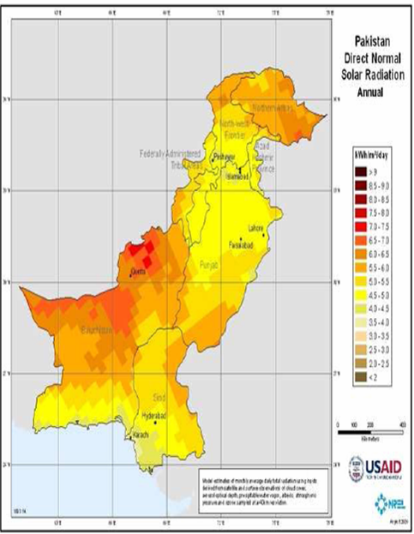
Why it is most favorable in Pakistan ?

Slide 14

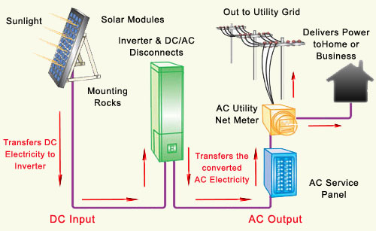

Slide 15

Objectives “Dominators Energy Solution”
To stabilize our base by increasing joint capital
To achieve break-even point
To grab the business of competitors

Slide 16

Goals
Short-Term
small government institutions.
gain business from small businesses like SME’s
Long-Term
Government institutions and especially ARMY.
target non-government corporate sector

Slide 17

Definition of the Market
Customers
Primary Customers
Secondary Customers
Competitors
U.P.S
Generators
WAPDA

Slide 18

Growth Strategy
Short Term
Small consumers and industries
Long Term
Government institutions

Slide 19

Marketing Strategy
Government Sector
Through marketing personals
Corporate and consumer sector
Advertising
Solar street lights and signals
Model office

Slide 20


Slide 21
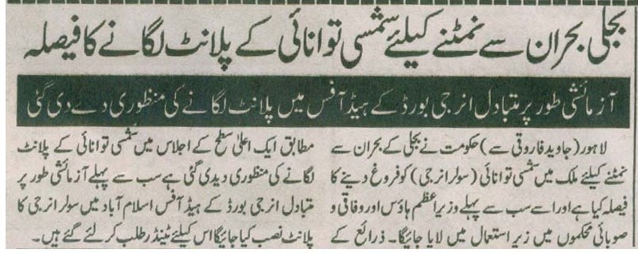

Slide 22

Pricing Strategy
One dimensional

Slide 23


DOMINATORS

Slide 24


Slide 25

Strengths
1)Internal and External contacts
2)Relevant experience and Sufficient
capital
3) Office Location
4)Marketing campaign
5)Premium quality equipment

Slide 26
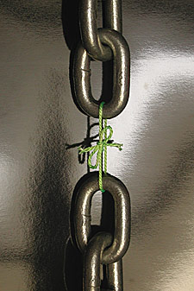
Weaknesses
Awareness level
Initial Cost
Big Space required
Lack of skills

Slide 27

Opportunities
Hot Atmosphere
Remote Areas
By targeting corporate and government sectors
Lack of Water

Slide 28
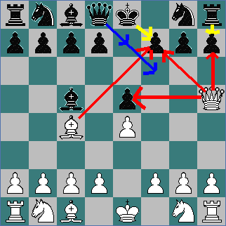
Threats
Existing Competitors
Government Taxes
Import Duties
Political Situations

Slide 29
Competitors Analysis
Competitors Strengths
UPS
GENERATOR
WAPDA
OTHER SOLAR ENERGY PROVIDERS
✓ Low initial cost
✓ Low maintenance cost
✓ Acceptability
✓ Awareness
✓ Less area occupied
✓ Govt. support
✓ Currently affordable
✓ High range provider of electricity
✓ Reliability
✓ Acceptability
✓ Less area occupied
✓ Higher acceptability
Good awareness
✓ Large distribution network
✓ Monopoly
✓ No initial cost
✓No maintenance expenses
✓ Less area required
 ✓Govt. support
✓ Technical & skilled experience staff
✓ More field experience
✓ Local domestic market experience

Slide 30
Competitors Weaknesses
UPS
GENERATOR
WAPDA
OTHER SOLAR ENERGY PROVIDERS
 ✓ Dependent on wapda
 ✓Charging fever
 ✓ Low life span
Low quality& performance
✓Number of complaints
✓ Dependent on oil
✓ Very noisy
✓ Environment polluted
✓Short life span
✓Electricity crises
✓Number of complaints
✓ Taxes
✓ Dependent on dams
✓ Lack of standardized equipments
✓ Initially high cost
✓ Have no experience at high level i.e. govt. institutions
 No experience at foreign, developed market
✓ Area coverage is high
✓ Import duty & taxes

Slide 31

Financial Overlook
2007 2008
Total Revenue 39.579 M 90.066 M
Gross Profit 6.362 M 16% 7.979 M 9%
Pre-tax Profit
Margin 97,275 0.25% 2.049 M 2.3%
Net Income 77,820 0.2% 1.639 M 1.82%

Slide 32

Financial Overlook (Ratio Analysis)
2007 2008
Return on Assets 0.31% 6.0%
Return on Equity 0.31% 6.45%
Profit on Sales 0.2% 1.82%
Profit to Total
Liabilities 57.34% 80.22%
Solvency Ratio 0.54% 33%

Slide 33

Bottom Line

Slide 34
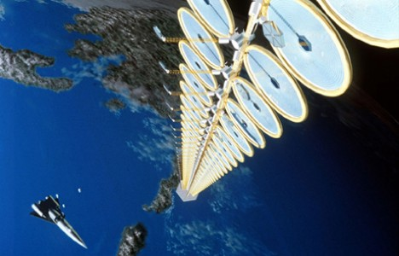
Future
Outlook
    Multinational Petrol Pumps
    Large Plazas
    Other Big Cities

Slide 35


